Slide 1


league of legends

Slide 2
The rise of LOL
League of legends was the most popular game in China between 2013 and 2015.
The success of it is due to strong social values.people play League of legends to fit in.
Competitivity and cooperation are the essential cores of league of legends.

Slide 3

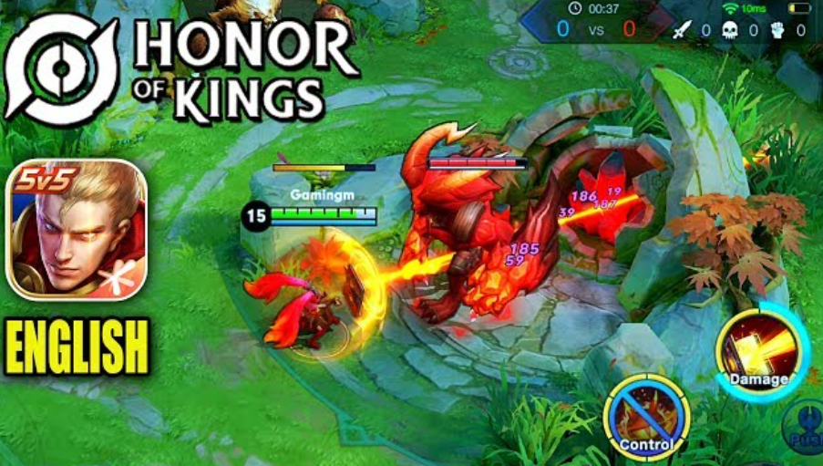
The fall of LOL
One of the critical reasons that caused the fall of LOL is social means shifting to mobile phones.
Honor of kings is a substitute for LOL on the mobile platform.
TikTok is another convenient way to consume time everywhere and at any time.

Slide 4
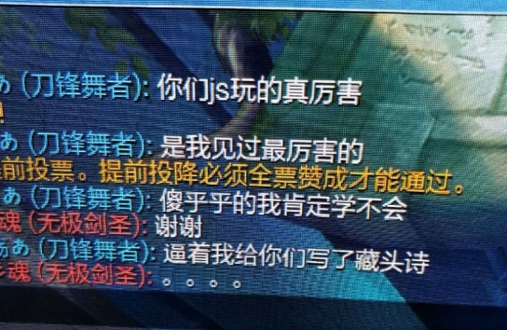
The toxic atmosphere in LOL
Verbal abuse in LOL is one of many common phenomenon that causes the toxic atmosphere.
Players abuse each other even over triffles with organs and mothers.
AFK and LTG are also commom in game.

Slide 5
The causes of the atmosphere
Comparison is the main cause of the atmosphere
1. League of Legends is a game in which cooperation and competition are essential cores of it.
2. In the comparison atmosphere in China, competition part is considered more important than cooperation.
3. That is to say, comparison is the way to self-identity, I am better than others. When losing a game means failing to construct the image of I that fits the comparison order.

Slide 6
The causes of the atmosphere
Comparison is the main cause of the atmosphere
4. In order to fit in the order again, hysteric subjects win in a perverted way in which negativity is the core of it. - I lose the game not because I am incapable, it is due to the teammates’ terrible performance, or not fully exerting my power.
5. As a result, League of legends is a game in which win is the only option, whether in positive or negative ways.

Slide 7
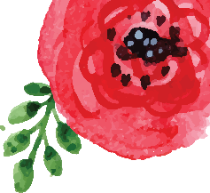

The comparison oder
1.By comparing, one finds his position in a symbolic order, comparing satisfies the pleasure of the big other(God).
2.Subjects are hysteric, they don’t know what the big other wants from them, anxiety drives them to satisfy the big other, but only find it is unsatisfied.
3.Losers have to win in the order, but in a negative way, losers are winners.

